Slide 1

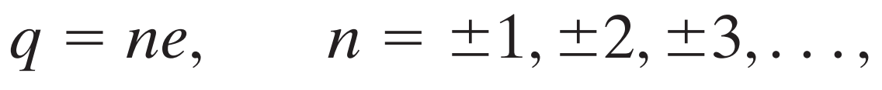
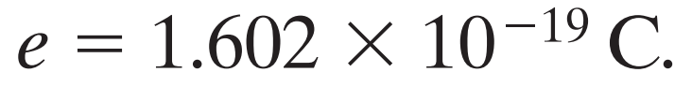
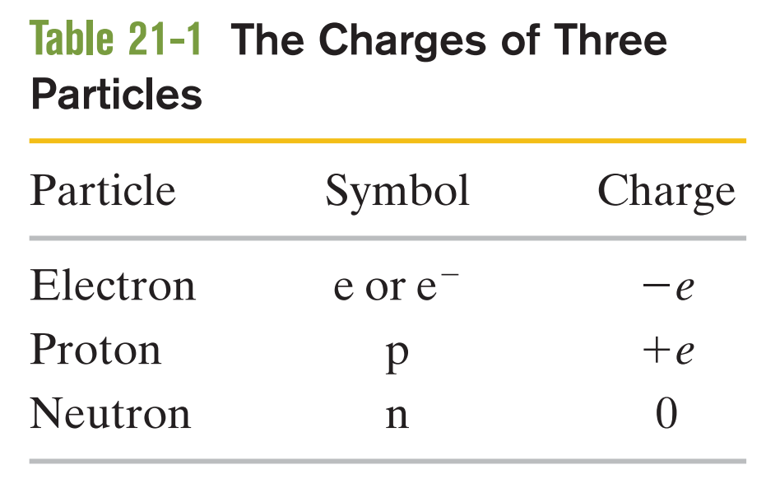
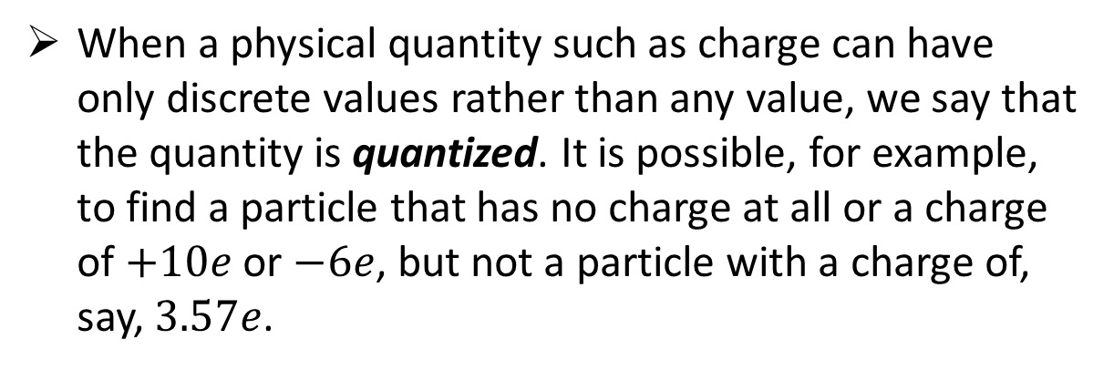
Any positive or negative charge q that can be detected can be written as
in which e, the elementary charge, has the approximate value
The elementary charge e is one of the important constants of nature. The electron and proton both have a charge of magnitude e
When a physical quantity such as charge can have only discrete values rather than any value, we say that the quantity is quantized. It is possible, for example, to find a particle that has no charge at all or a charge of $+10e$or $−6e$, but not a particle with a charge of, say, $3.57e$.
Notes:
Identify that the charge of a particle or object must be a positive or negative integer times the elementary charge.

Slide 2

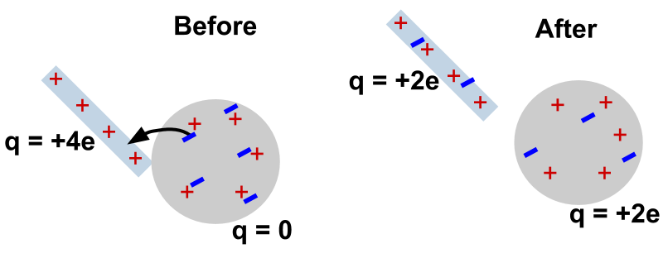
The net electric charge of any isolated system is always conserved.
Notes:
pair production, in physics, formation or materialization of two electrons, one negative and the other positive (positron), from a pulse of electromagnetic energy traveling through matter, usually in the vicinity of an atomic nucleus. Pair production is a direct conversion of radiant energy to matter.

Slide 3
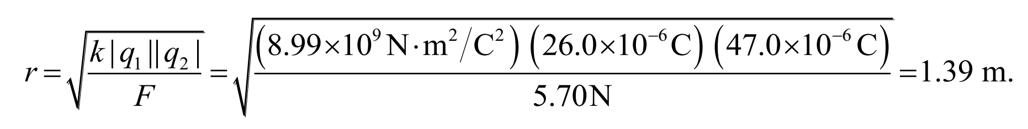
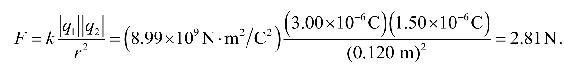
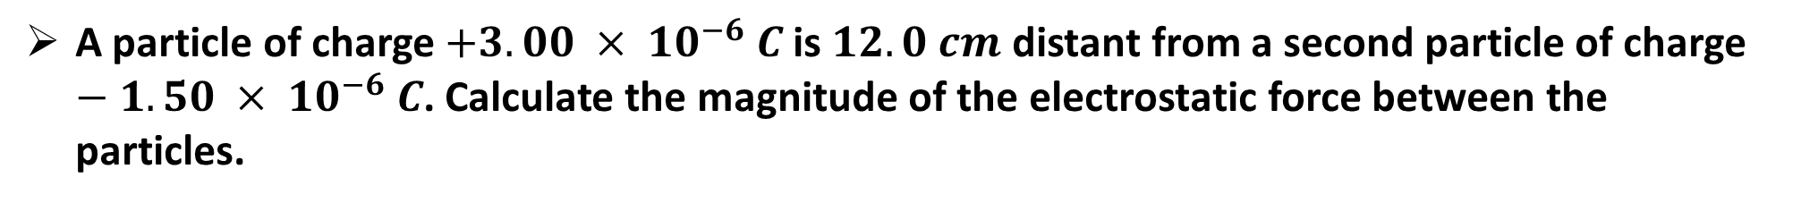
What must be the distance between point charge $q1=26.0 μC$and point charge $q2=−47.0 μC$for the electrostatic force between them to have a magnitude of $5.70 N$?
A particle of charge $+3.00 × {10}^{−6} C$is $12.0 cm$distant from a second particle of charge $−1.50 × {10}^{−6} C$. Calculate the magnitude of the electrostatic force between the particles.

Slide 4
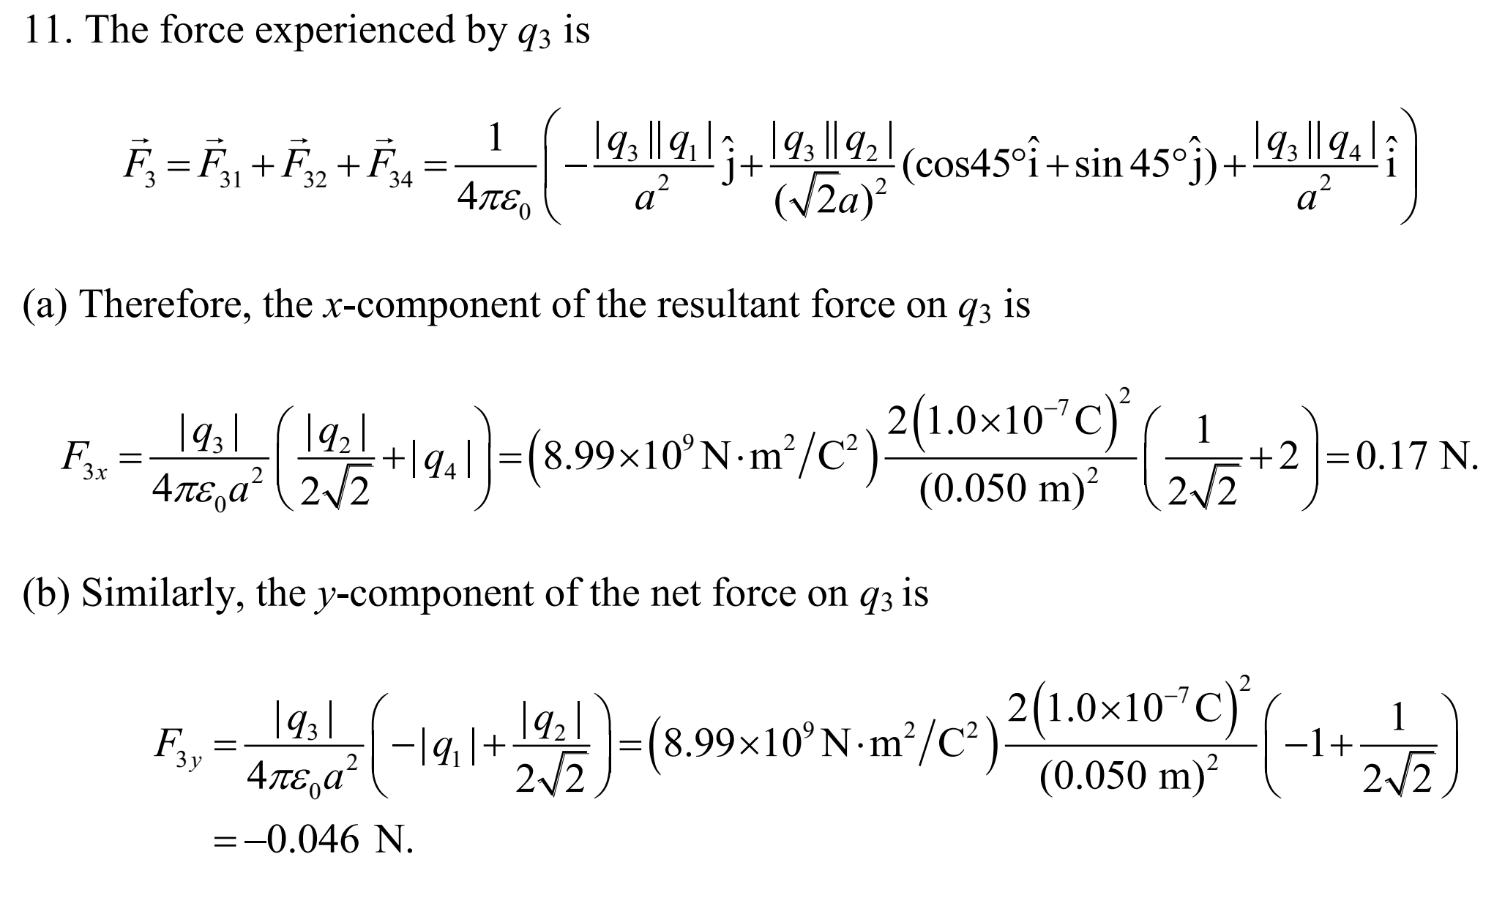
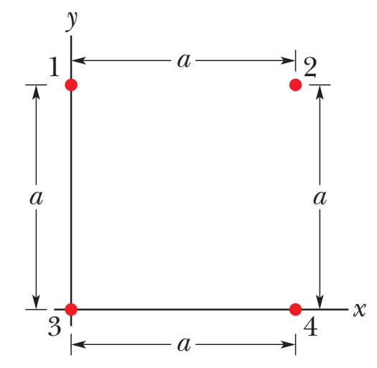
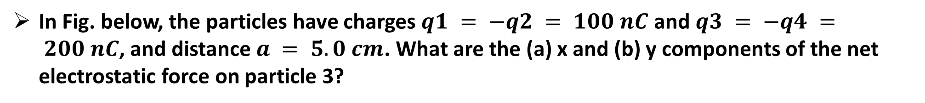
In Fig. below, the particles have charges $q1 = −q2 = 100 nC$and $q3 = −q4 = 200 nC$, and distance $a = 5.0 cm$. What are the (a) x and (b) y components of the net electrostatic force on particle 3?

Slide 5

Chapter 22 from the textbook: Fundamentals of Physics

Slide 6
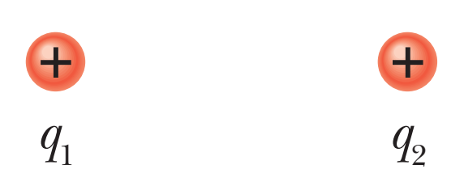
We know that when positive ( or negative) charge approaching another Positive ( or negative) there will be electrostatic force acts on particles 1 due to the particle 2.
However, here is a leftover nagging question. How does particle 1 “know” of the presence of particle 2? That is, since the particles do not touch, how can particle 2 push on particle 1—how can there be such an action at a distance?
The explanation that we shall examine here is this: Particle 2 sets up an electric field at all points in the surrounding space, even if the space is a vacuum.
Our goals in this part of the chapter are to (1) define electric field, (2) discuss how to calculate it for various arrangements of charged particles and objects, and (3) discuss how an electric field can affect a charged particle (as in making it move)

Slide 7

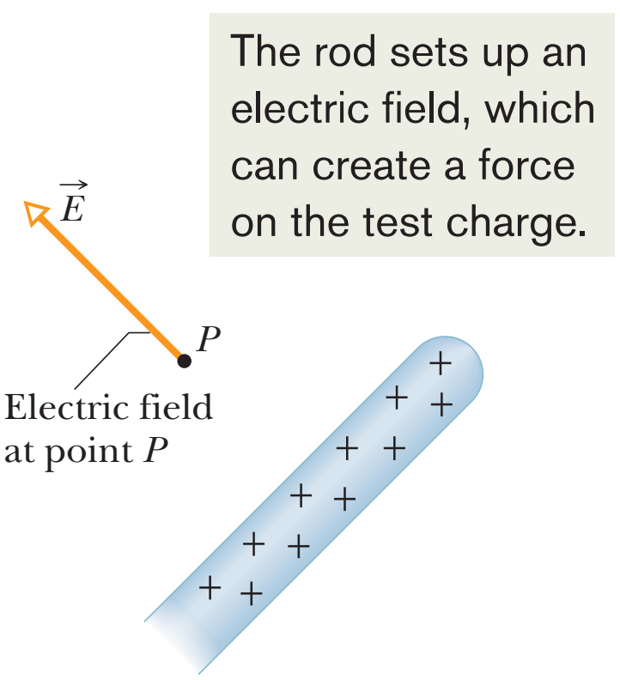
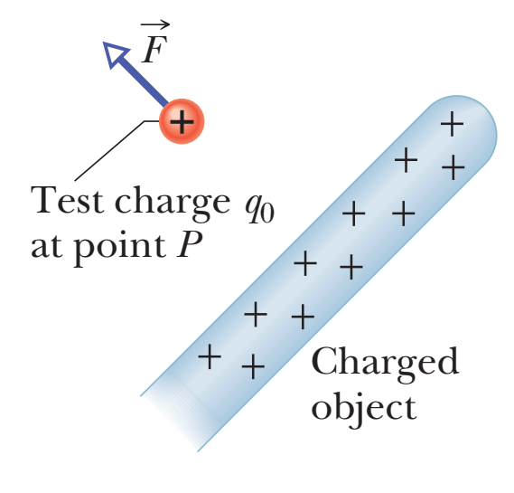
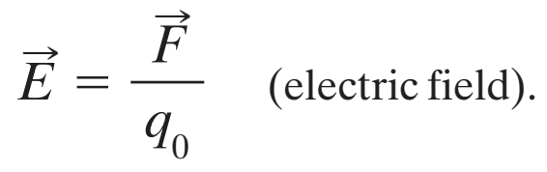
An electric field is a vector field because it is responsible for conveying the information for a force, which involves both magnitude and direction. This field consists of a distribution of electric field vectors , one for each point in the space around a charged object.
The electric field at test point is
Unit is newton per coulomb (N/C)
Electric force is a push or pull. Electric field is an abstract property set up by a charged object.

Slide 8

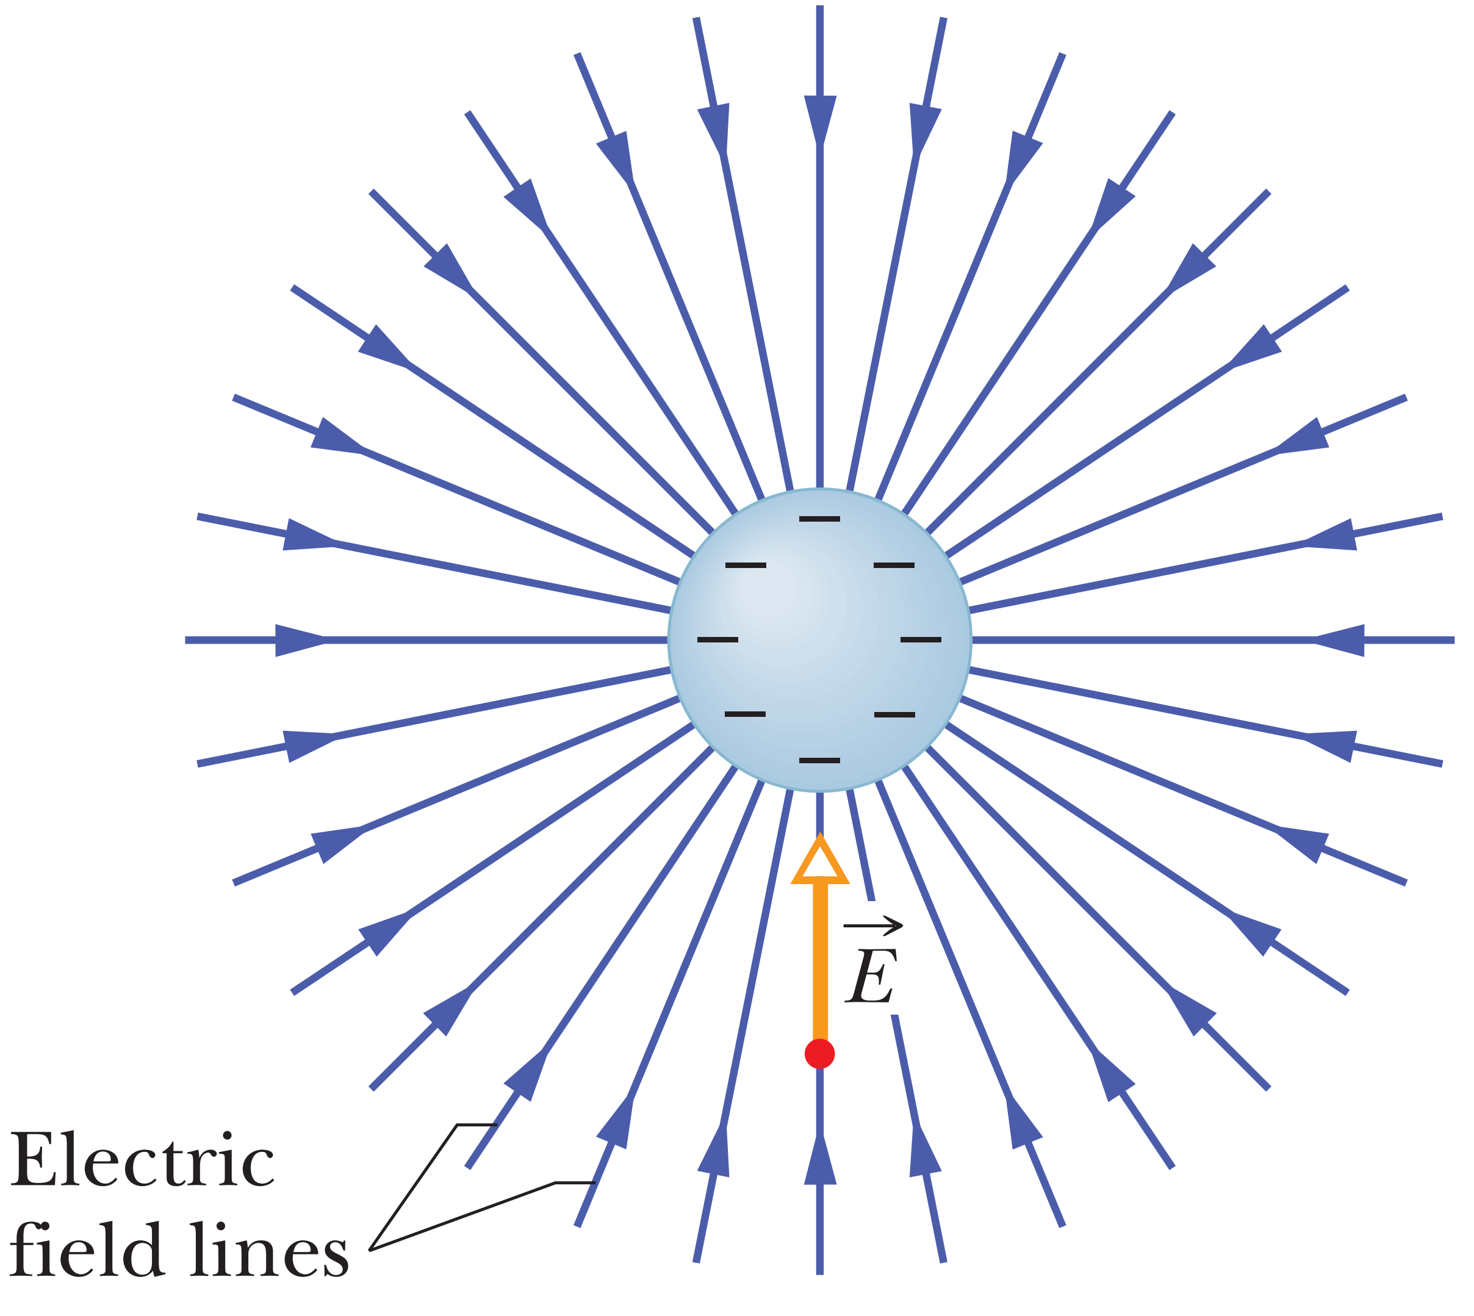
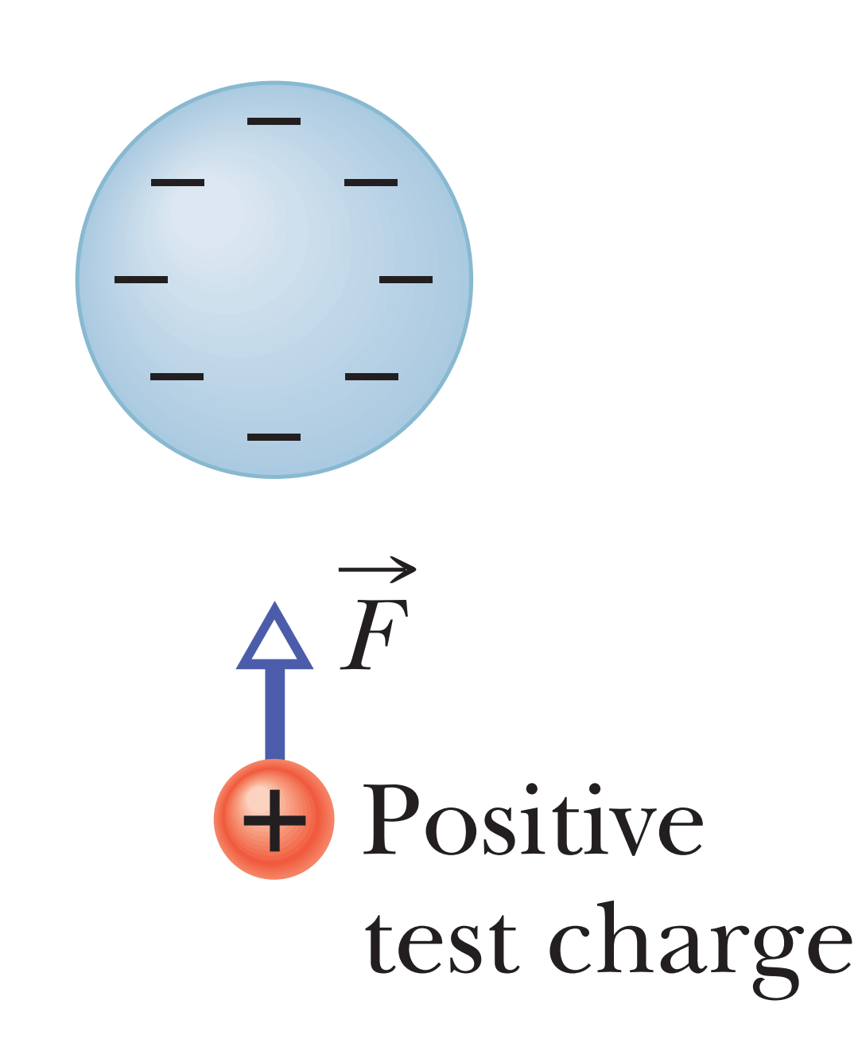
Michael Faraday, who introduced the idea of electric fields in the 19th century, found a way. He envisioned lines, now called electric field lines, in the space around any given charged particle or object.
It is imaginary lines to
visualize The Electrical Field

Slide 9
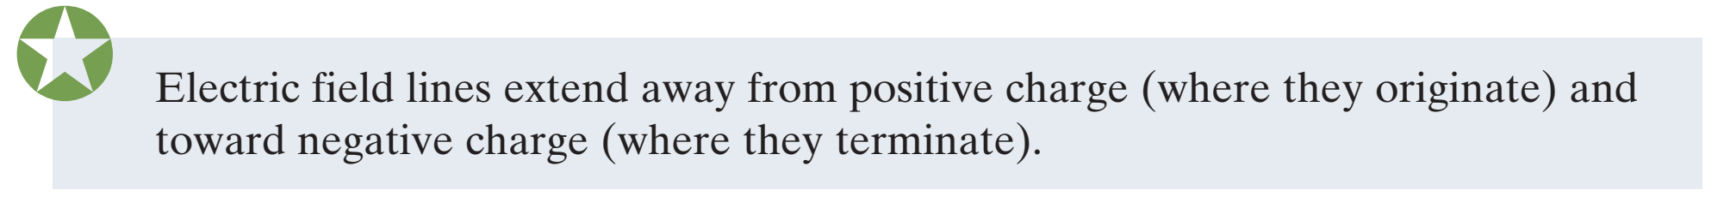
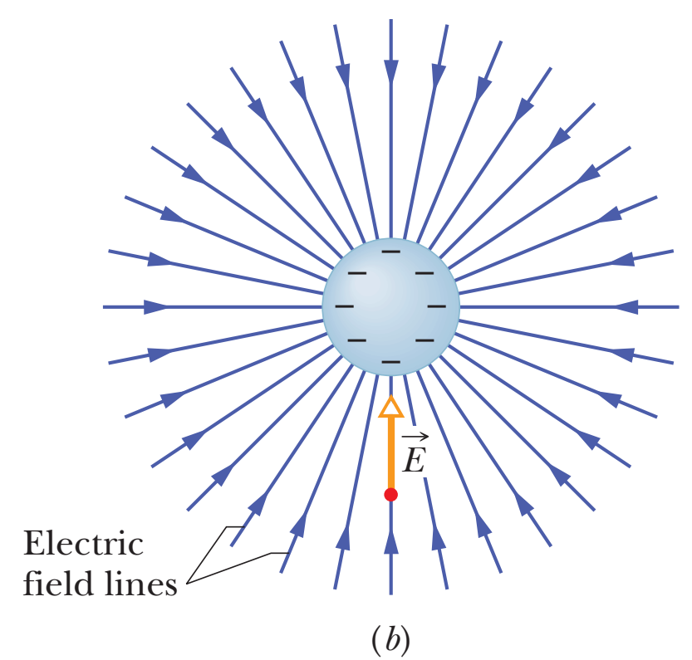
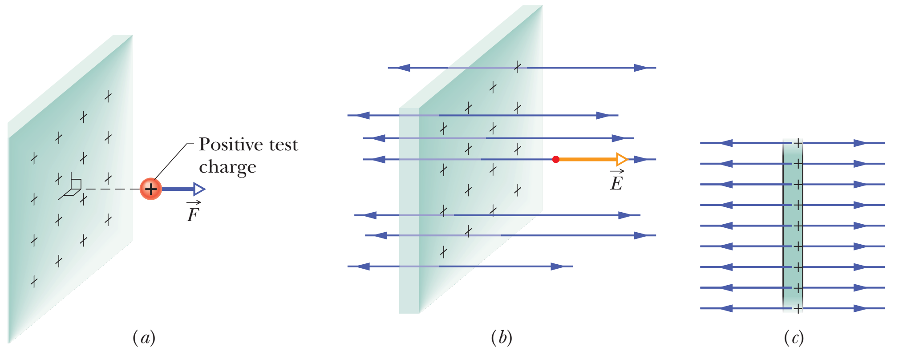
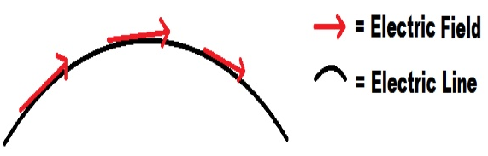
The rules for drawing electric fields lines are these:
At any point, the electric field vector must be tangent to the electric field line through that point and in the same direction.
In a plane perpendicular to the field lines, the relative density of the lines represents the relative magnitude of the field there, with greater density for greater magnitude.

Slide 10
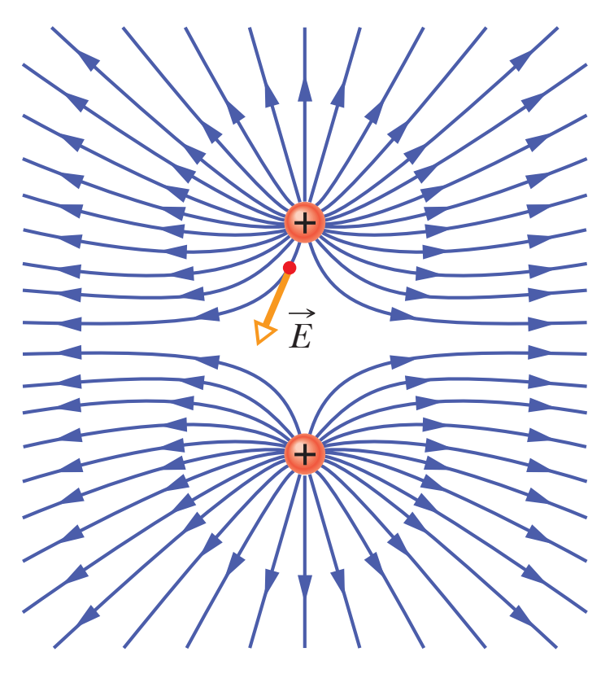
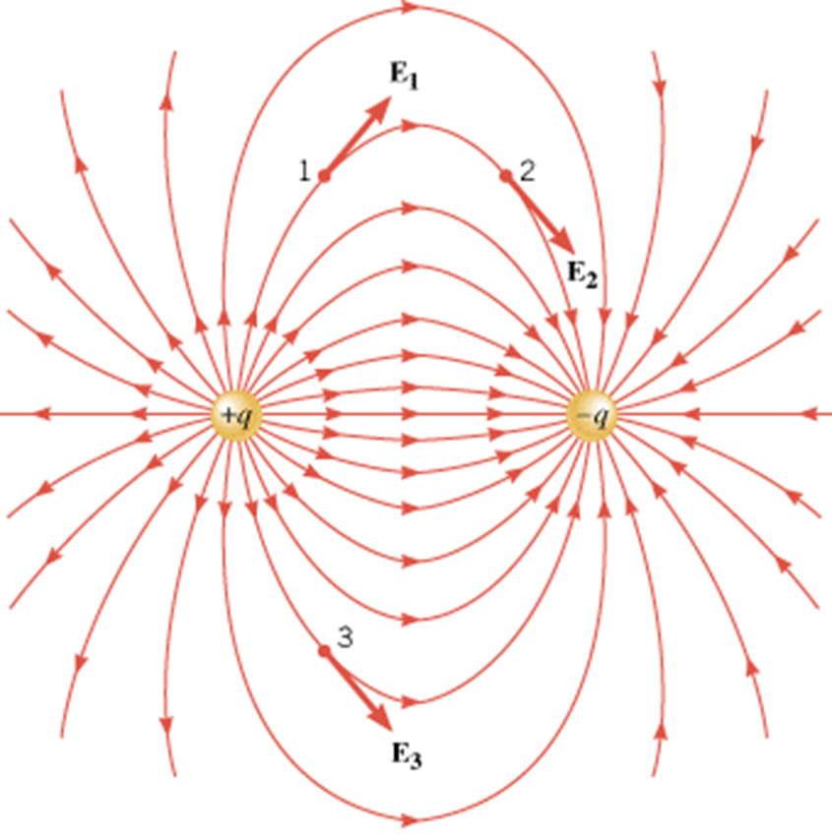
The figure shows the field lines for two particles with equal positive charges. Now the field lines are curved, but the rules still hold:
The electric field vector at any given point must be tangent to the field line at that point and in the same direction, as shown for one vector.
A closer spacing means a larger field magnitude.

Slide 11
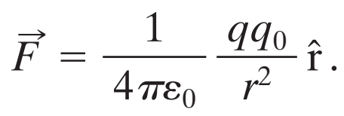
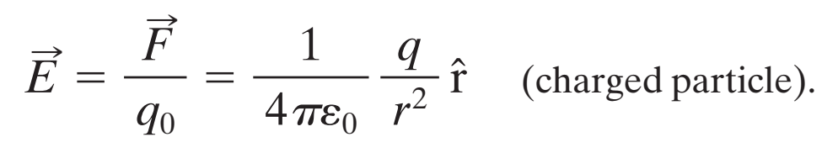
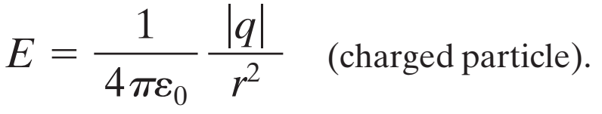
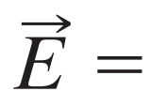
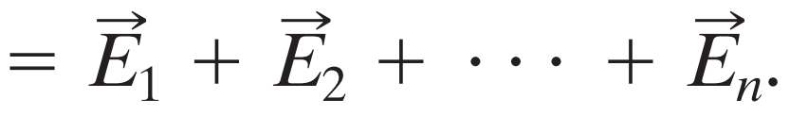
To find the electric field due to a charged particle
From Coulomb’s law, the force on the test charge due to the particle with charge q is
The electric field set up by the particle
The magnitude
Electric fields obeys the principle of superposition.

Slide 12
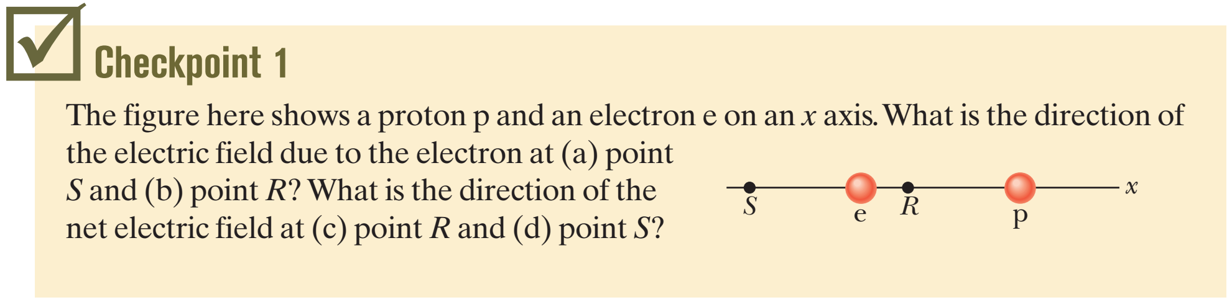
(a) rightward; (b) leftward; (c) leftward; (d) rightward (p and e have same charge magnitude, and p is farther)

Slide 13
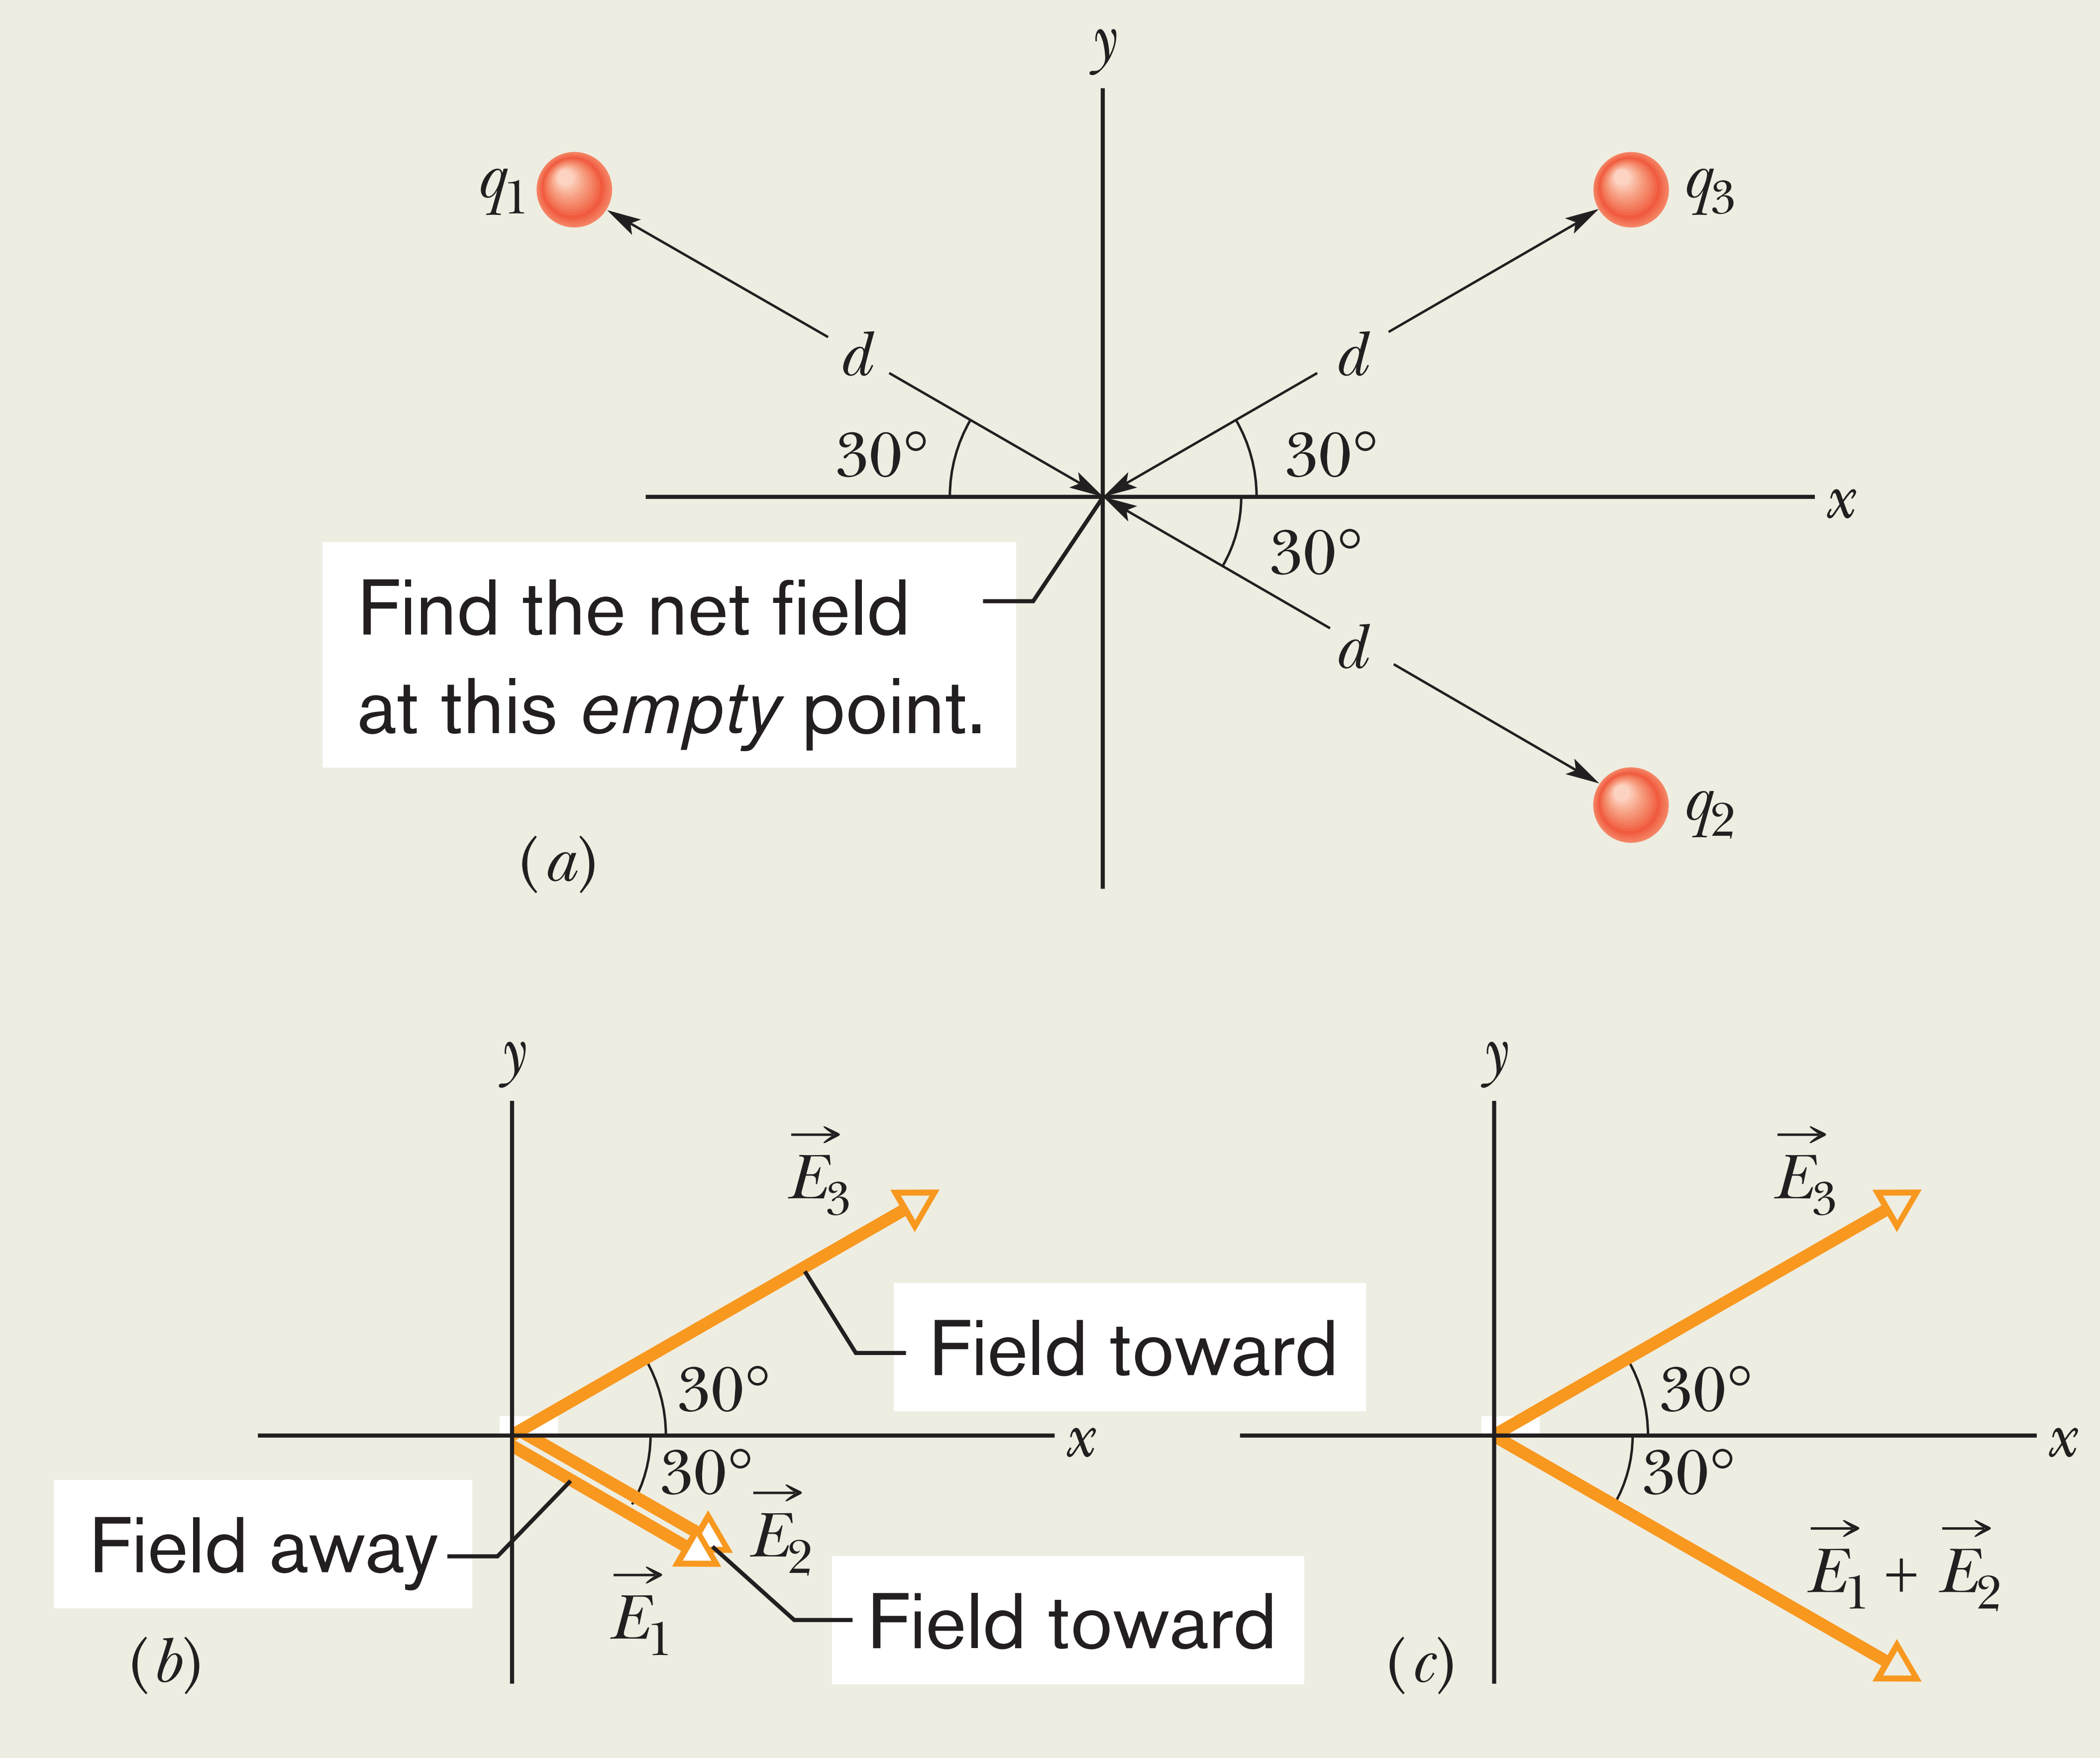
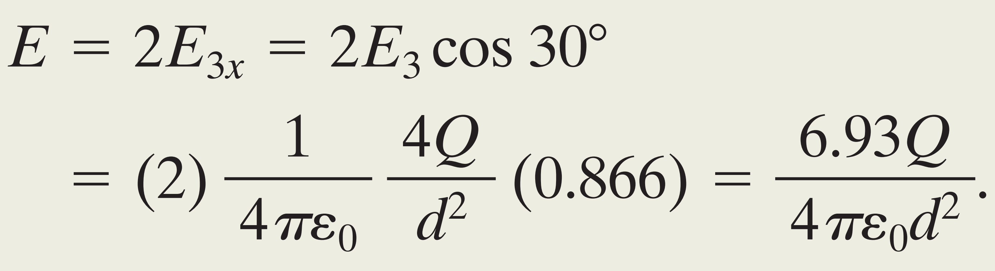
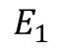
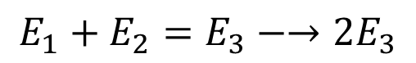
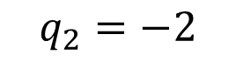

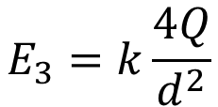
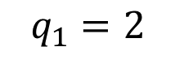
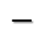
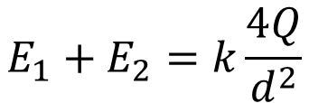

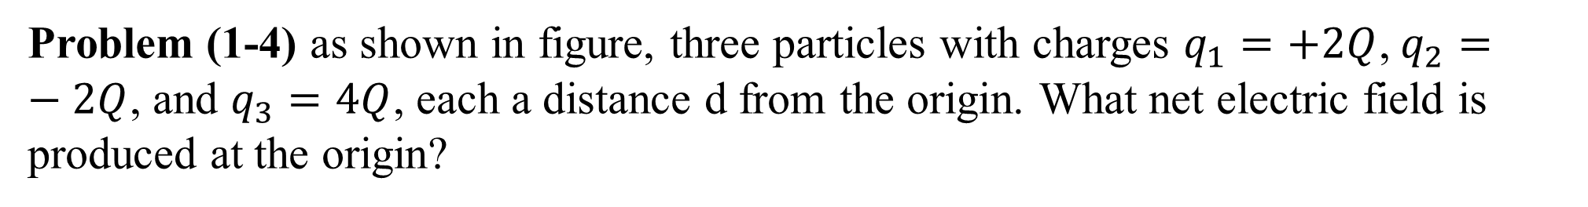
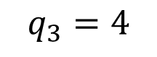
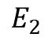
Problem (1-4) as shown in figure, three particles with charges $q_{1}=+2Q$, $q_{2}=−2Q$, and $q_{3}=4Q$, each a distance d from the origin. What net electric field is produced at the origin?
$$E_{3}=k\frac{4Q}{d^{2}}$$
$$q_{1}=2$$
$$q_{3}=4$$
$$+$$
$$+$$
$$E_{1}$$
$$E_{1}+E_{2}=k\frac{4Q}{d^{2}}$$
$$E_{1}+E_{2}=E_{3}−→2E_{3}$$
$$E_{2}$$
$$−$$
$$q_{2}=−2$$

Slide 14
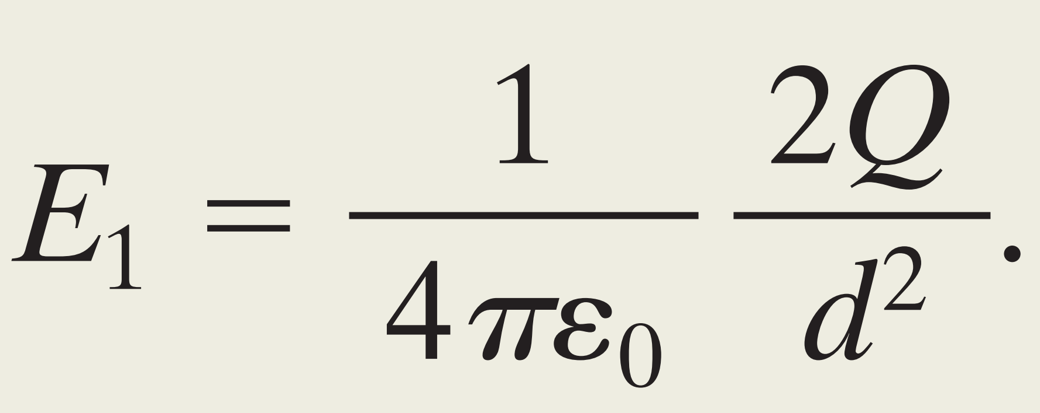
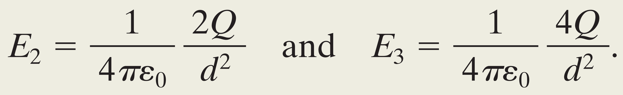
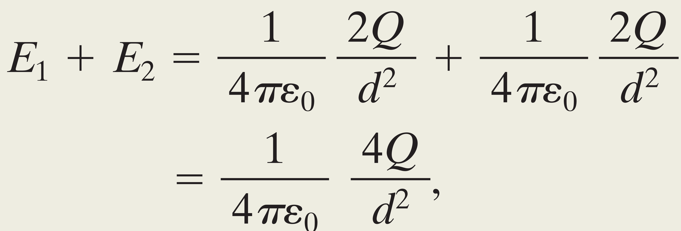
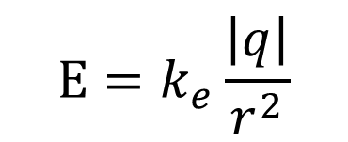
$$E=k_{e}\frac{\left|q\right|}{r^{2}}$$

Slide 15
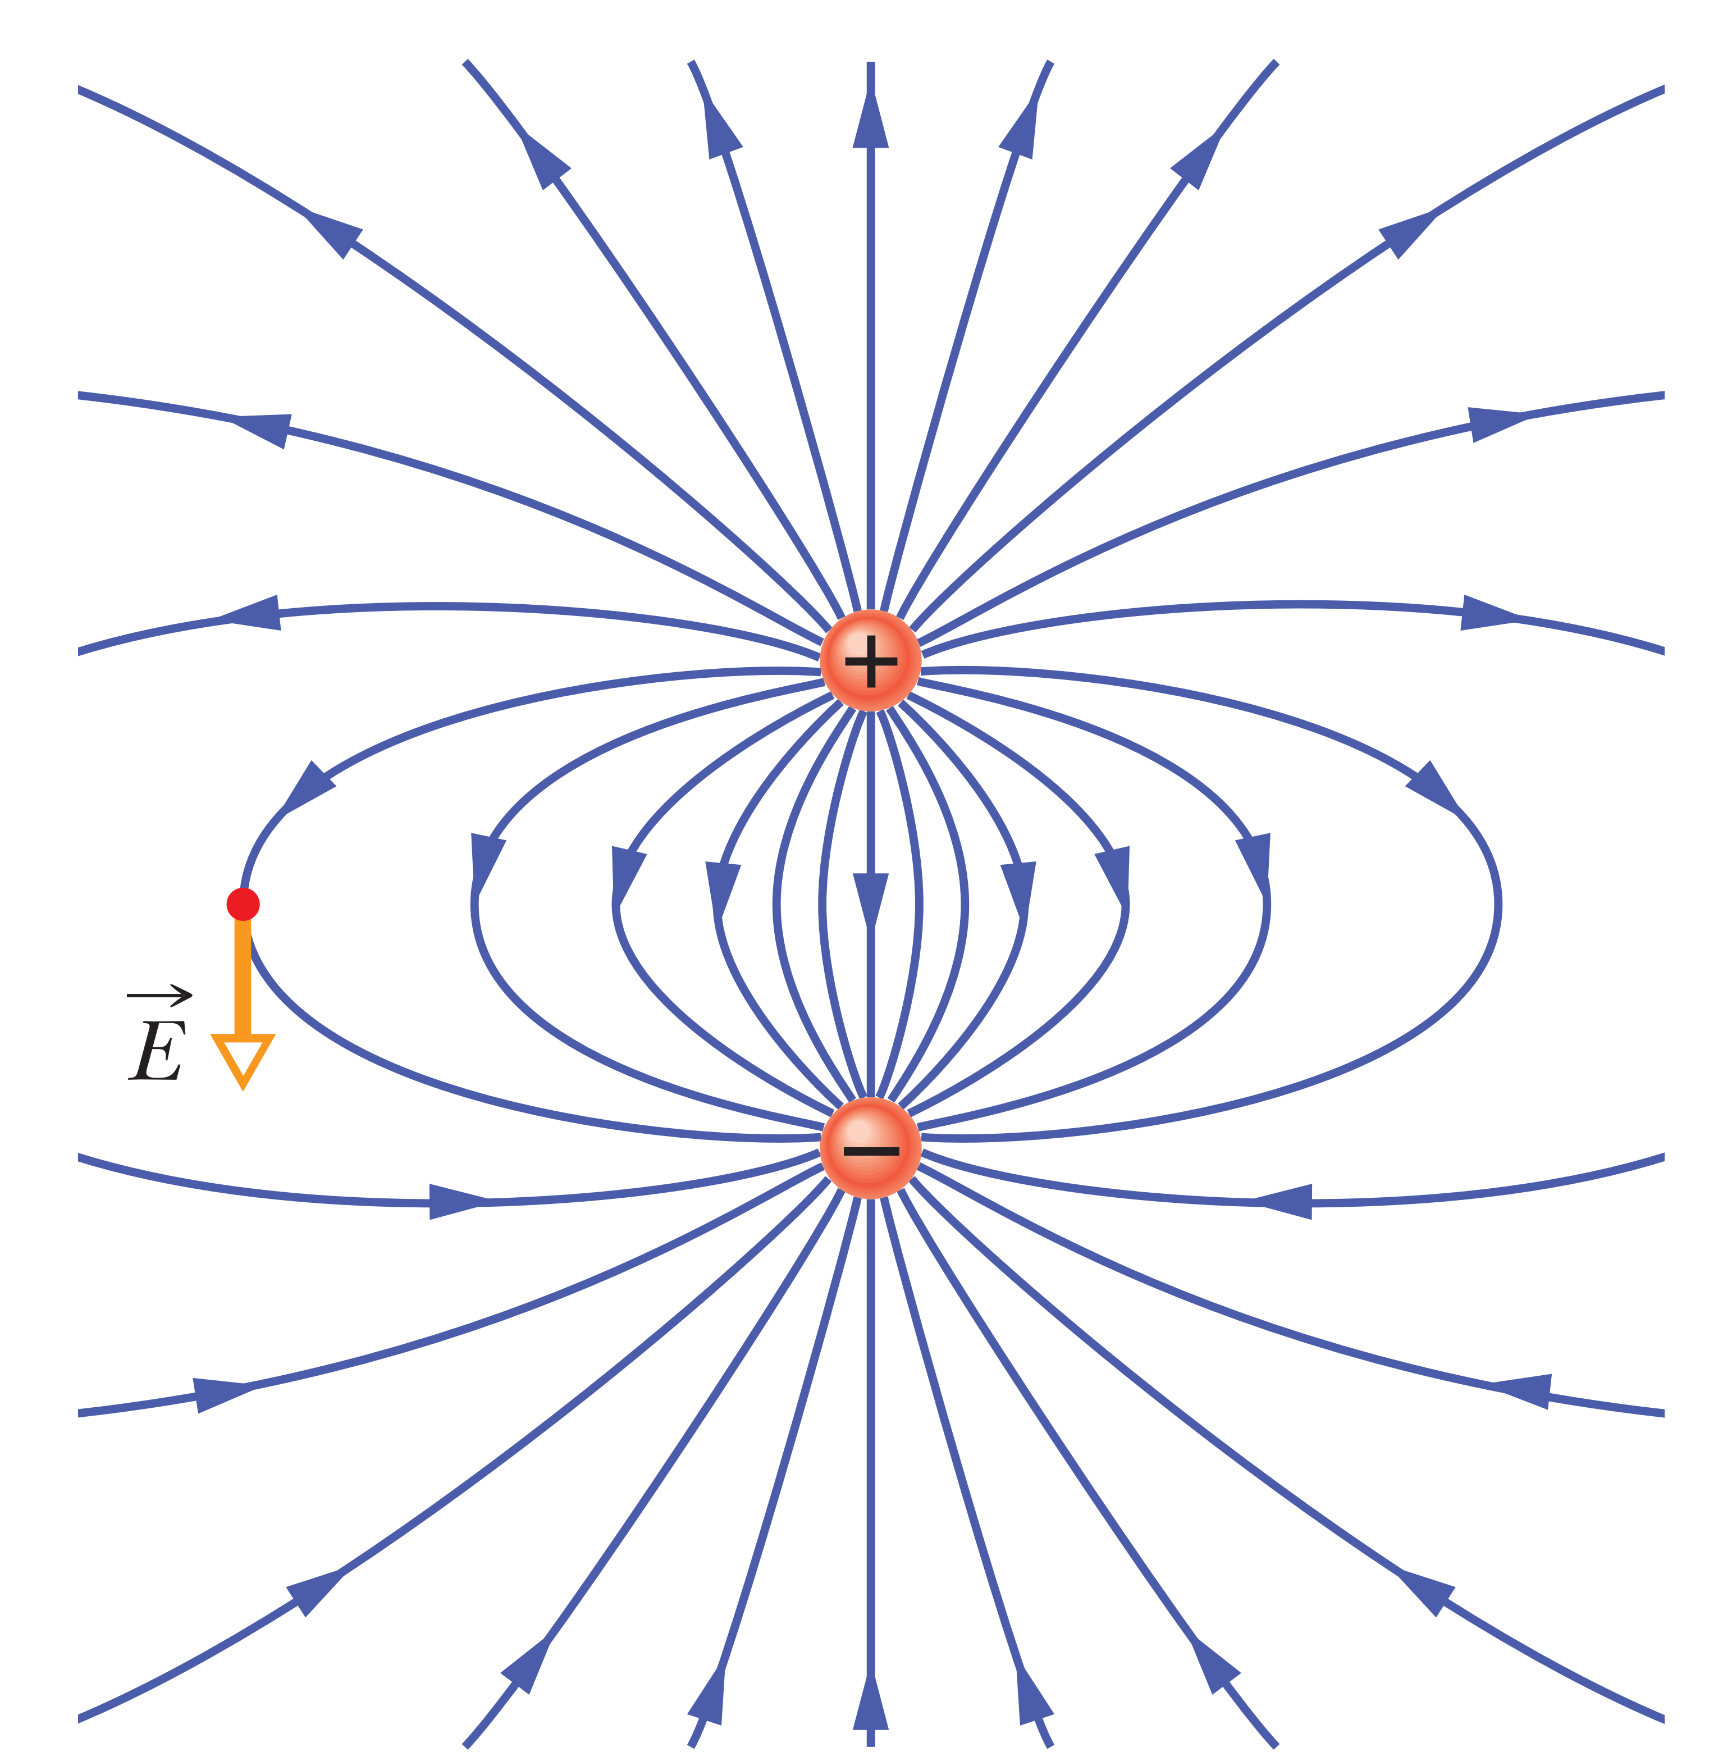
The pattern of electric field lines for two particles that have the same charge magnitude q but opposite signs, known as an electric dipole.

Slide 16
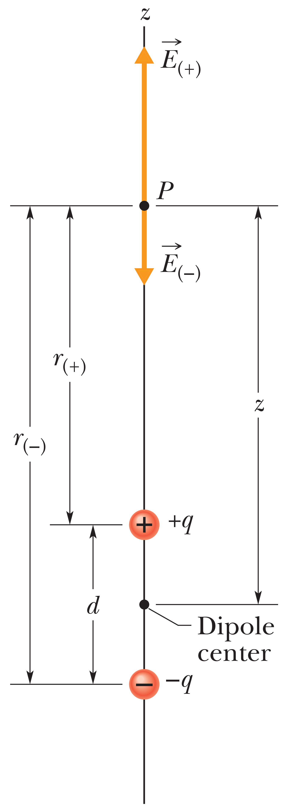
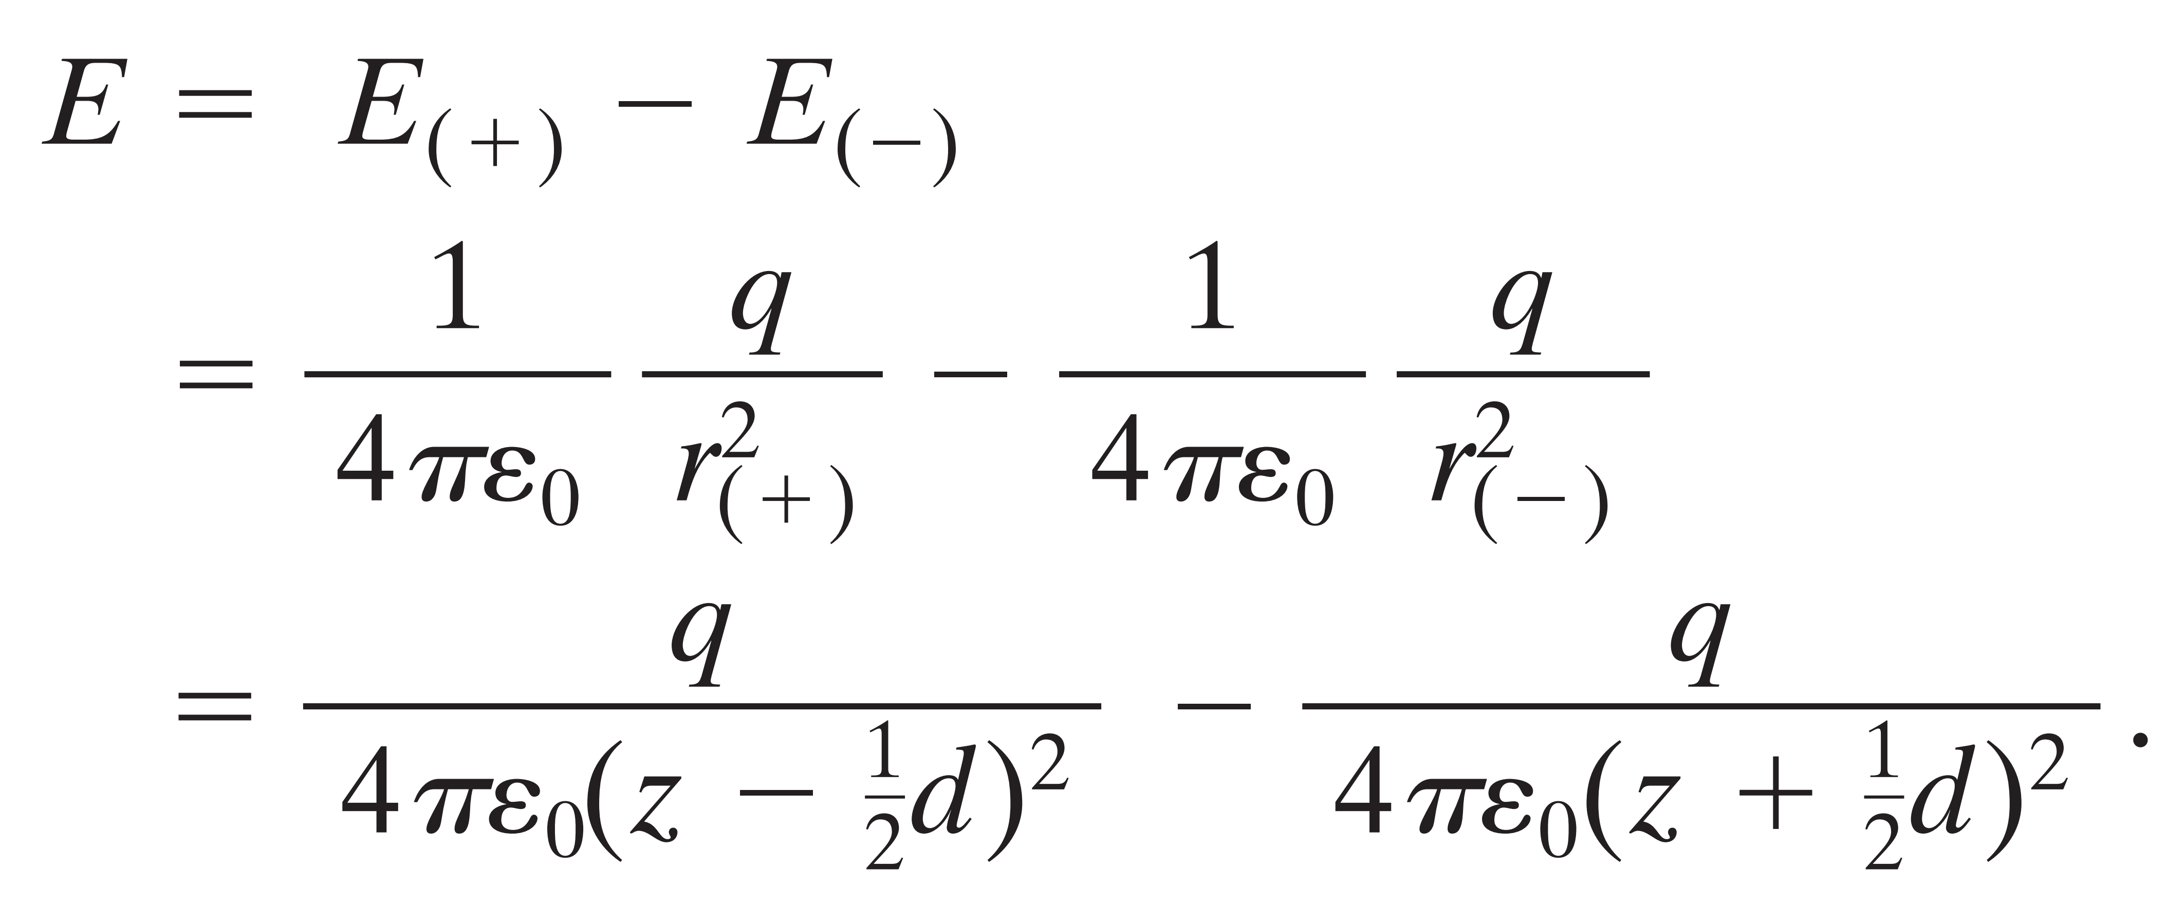

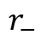
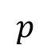






$$p$$
$$r_{+}$$
$$z$$
$$r_{+}=(z−\frac{1}{2}d)$$
$$r_{−}$$
$$−$$
The green line
$$r_{−}=(z+\frac{1}{2}d)$$
$$d$$
The black line
$$+$$

Slide 17







Where
$qd$ known as the electric dipole moment $\vec{P}$

Slide 18






Example for dipole
A vertical electric dipole that has charge $−q$ at cloud height $h$ and charge $+q$ at below-ground depth $h$ . If $q=200 C$ and $h=6.0 km$, what is the magnitude of the dipole’s electric field at altitude $z1=30 km$somewhat above the clouds and altitude $z2=60 km$somewhat above the stratosphere?
sprites lightning
We have
where $2h$ is the
separation between
$+q$ and $−q$

Slide 19





For the electric field at altitude
$$z1=30 km$$
$$z1=60 km$$
when the magnitude of an electric field exceeds a certain critical value $E_{c}$, the field can pull electrons out of atoms (ionize the atoms), and then the freed electrons can run into other atoms, causing those atoms to emit light. The value of $E_{c}$depends on the density of the air in which the electric field exists.
Density fo air is so low at $z1=60 km$ while high at $z1=30 km$

Slide 20

The electric field due to a line of charge
This is as good a place as any to generalize from point charges to continuous charge distributions. A volume distribution of charge is described by a scalar charge-density function ρ, which is a function of position, with the dimensions charge/volume. That is, ρ times a volume element gives the amount of charge contained in that volume element.

Slide 21



In the preceding four modules we worked at the first of our two tasks: given a charge distribution, to find the electric field it produces in the surrounding space. Here we begin the second task: to determine what happens to a charged particle when it is in an electric field set up by other stationary or slowly moving charges.
in which $q$ is the charge of the particle (including its sign) and is the electric field that other charges have produced at the location of the particle. (The field is not the field set up by the particle itself; to distinguish the two fields, the field acting on the particle is often called the external field. A charged particle or object is not affected by its own electric field.)

Slide 22
Some examples and application of the charge inside the electric field
Measuring the Elementary Charge
Ink-Jet Printing
H.W
Electrical Breakdown and Sparking

Slide 23


The end of the 2nd part of Ch1

Slide 24



In Fig. below the electric field lines on the left have twice the separation of those on the right. (a) If the magnitude of the field at A is $40 N/C$, what is the magnitude of the force on a proton at A? (b) What is the magnitude of the field at B?

Slide 25


Two charged particles are attached to an x axis: Particle 1 of charge $−2.00 × 10^{−7} C$is at position $x = 6.00 cm$and particle 2 of charge $+2.00 × 10^{−7} C$is at position $x = 21.0 cm$. Midway between the particles, what is their net electric field in unit-vector notation?

Slide 26

What is the magnitude of a point charge that would create an electric field of $1.00 N/C$ at points $1.00 m$away?

Slide 27



In Fig. below, the four particles form a square of edge length $a = 5.00 cm$and have charges $q1 = +10.0 nC, q2 = −20.0 nC, q3 = +20.0 nC,$and $q4 = −10.0 nC$. In unit-vector notation, what net electric field do the particles produce at the square’s center?

